Slide 1
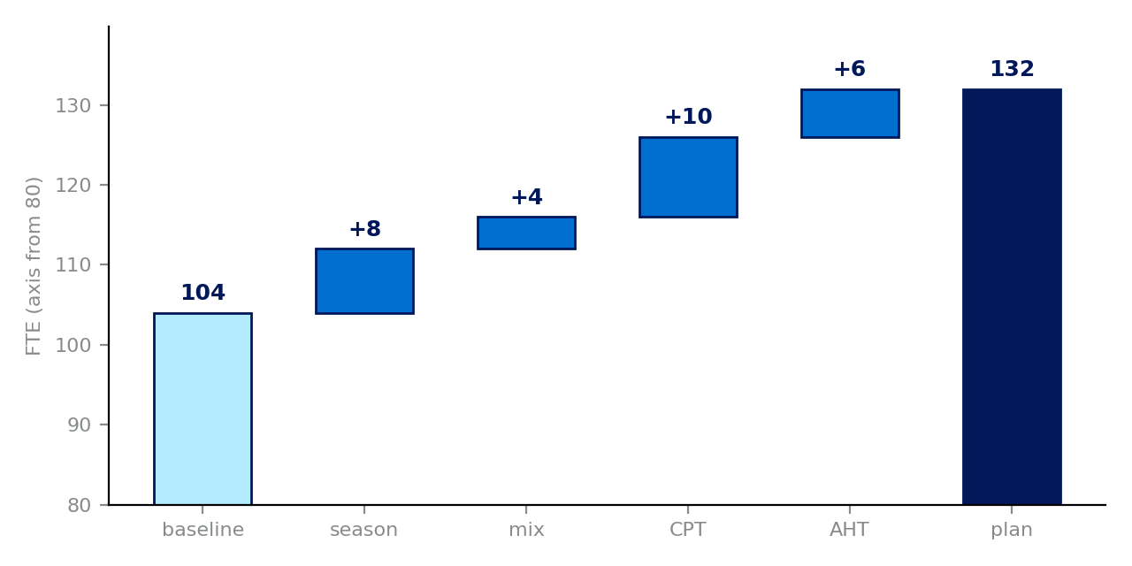
Plan 132 FTE against a 104 baseline; contacts per transaction moves it most
Every step traces to a row on the departure–arrival grid
• +28 FTE from baseline to plan
• 3 problems · 6 watch · 2 unknown
• Most uncertain: contacts per transaction, by country (−10 / +12)
• 13 open questions · 7 mandatory rows empty
‹Illustrative migration› · archetype C · as of 2026-10-06

Slide 2
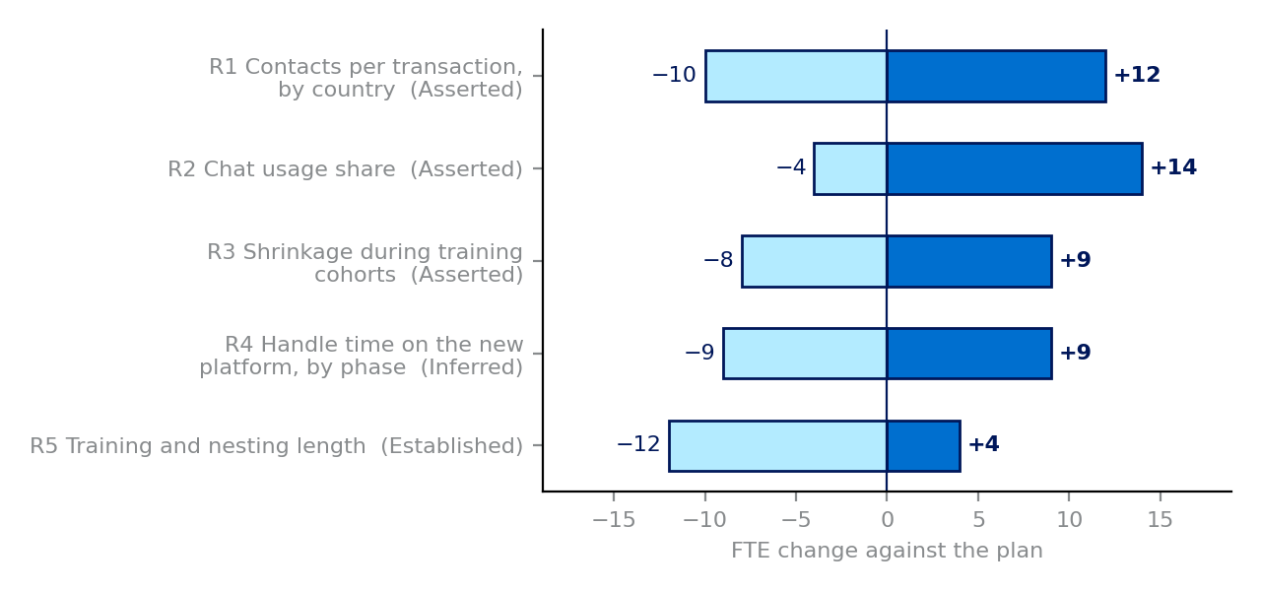
3 problems need action; the plan rests most on contacts per transaction
Why the plan holds, and where it may not: Problem and Watch rows, and the open assumptions that move it most
# | Characteristic | Call | FTE | Owner
3 | Operating model | Problem | +4 | arrival lead
8 | Contacts per transaction, by country | Problem | +10 | departure lead
9 | Seasonality and weekly shape | Watch | +8 | departure lead
13 | Chat usage share | Watch | 0 | arrival lead
17 | Languages supported | Problem | not sized | arrival lead
23 | Service level target | Watch | 0 | arrival lead
27 | Handle time on the new platform, by phas | Watch | +6 | arrival lead
29 | Shrinkage during training cohorts | Watch | 0 | operations lead
30 | Training and nesting length | Watch | 0 | operations lead
‹Illustrative migration› · archetype C · as of 2026-10-06

Slide 3
13 questions are open and 2 values are not yet held
Asks and decisions: what is not yet known, who owns it, and what needs deciding
Not yet held
Row 14 how chat behaves: sync or async: arrival lead, by 2026-10-20
Row 34 client told what will change: sponsor, by 2026-10-20
Arrival lead
Q1 (row 14): At arrival, does chat run synchronously or asynchronously? The planning call left…
Q3 (row 17): Which languages will the arriving teams cover at go-live, and where does work in…
Q5 (row 3): What range should the loss of pooling from in-country teams carry? Row 3 has +4…
Q8 (row 27): For how many weeks does phase-1 handle time stay above steady state?
Q12 (row 22): Which entry points will customers use at arrival, and how long will caller…
Departure lead
Q4 (row 8): Contacts per transaction of 0.31: which months, which markets, and what is the…
Q9 (row 2): Which markets move in each phase, and on what dates?
Q10 (row 7): What is the transaction volume for the migrating markets, and is a transaction…
Q11 (row 20): What share of contacts arrives by voice today, and what share is expected after the…
Q13 (row 24): What share arrives by email today, and what turnaround applies at arrival?
Q14 (row 26): What is handle time by channel and country in the client's own pre-migration months?
Sponsor
Q2 (row 34): Has the client been told that its own chat is being replaced, and by when?
Q15 (row 35): When will the incoming plan be laid against the outgoing plan, and who signs it?
Decisions needed (Problems)
• Row 3, operating model: One 24-hour pool → In-country, business hours (owner: arrival lead)
• Row 8, contacts per transaction, by country: 0.31 — own pre-migration months → 0.34 — new entry points (owner: departure lead)
• Row 17, languages supported: EU + Asia → EU only (owner: arrival lead)
‹Illustrative migration› · archetype C · as of 2026-10-06

